Slide 1
Redux & Redux-Saga & Immer Session
State Management With Redux
@VnyDev

Slide 2
Session Topics
Introduction of State Management
Mutable And Immutable Object In Javascript
Iterators & Generators
Immer introduction
Redux Introduction
Redux & Redux DevTool
Redux-Saga
Application architecture with Redux-Saga

Slide 3
State Management
Application state management is the process of maintaining knowledge of an application's inputs across multiple related data flows that form a complete business transaction or a session to understand the condition of the app at any given moment. In computer science, an input is information put into the program by the user and state refers to the condition of an application according to its stored inputs saved as variables or constants. A state can also be described as the collection of preserved information that forms a complete session.

Slide 4
Mutable And Immutable Object In Javascript
What is Mutable and Immutable Object ?
A mutable object is an object whose state can be modified after it is created.
Immutables are the objects whose state cannot be changed once the object is created.
Mutable is a type of variable that can be changed. In JavaScript, only objects and arrays are mutable, not primitive values.
You can make a variable name point to a new value, but the previous value is still held in memory. Hence the need for garbage collection
Strings, Numbers, Boolean are Immutable.

Slide 5
Iterators & Generators
Iterators:-
In JavaScript an iterator is an object which defines a sequence and potentially a return value upon its termination.
Specifically, an iterator is any object which implements the Iterator protocol by having a next() method that returns an object with two properties { value: ” ”, done: false }.
Generator:-
Generator functions provide a powerful alternative: they allow you to define an iterative algorithm by writing a single function whose execution is not continuous. Generator functions are written using the function* syntax.
When called, generator functions do not initially execute their code. Instead, they return a special type of iterator, called a Generator. When a value is consumed by calling the generator's next method, the Generator function executes until it encounters the yield keyword.
yield* - The yield* expression is used to delegate to another generator or iterable object.
yield - The yield keyword pauses generator function execution and the value of the expression following the yield keyword is returned to the generator's caller. It can be thought of as a generator-based version of the return keyword.
Custom Iterator object const SomeObj = {
*[Symbol.iterator] () {
yield 'a';
yield* delay(1000)
yield 'b';
}
};
var iterator = SomeObj[Symbol.iterator];
Generator function expression function* sample { ……. }

Slide 6
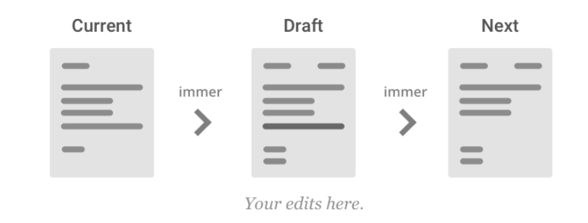
Immer JS
Immer (German for: always) is a tiny package that allows you to work with immutable state in a more convenient way. It is based on the copy-on-write mechanism.
The basic idea is that you will apply all your changes to a temporary draftState, which is a proxy of the currentState. Once all your mutations are completed, Immer will produce the nextState based on the mutations to the draft state. This means that you can interact with your data by simply modifying it while keeping all the benefits of immutable data.

Slide 7
What is a Redux?
Redux is a state container for JavaScript apps, often called a Redux store. It stores the whole state of the app in an immutable object tree. The only way to change the state tree is to emit an action and action take payload and type of the context which decide the updation in store by pure reducer function.
Store: - A store contain the single source of object tree which work on three core principle of the redux.
Single source of truth (The global state of your application is stored in an object tree within a single store).
State is a read-only (The only way to change the state is to emit an action, an object describing what happened).
Changes are made with pure functions (Reducers are just pure functions that take the previous state and an action, and return the next state.)

Slide 8
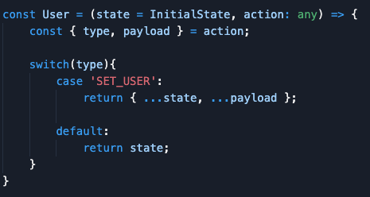
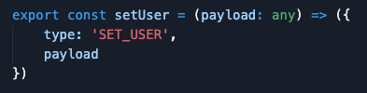
Action & Reducer Function
Action function take payload as data and return a object with type and payload. It’s emit only with dispatch method of the redux store.
Reducer is pure function which take initialstate and action, action contain type and payload (data) on the bases of type reducer update state in store and return new state.

Slide 9
Redux WorkFlow Diagram
UI Layer
Action
Dispatch
Type & Payload
Dispatch action event
Type
Return updated state
Based on action Type reducer update state
Redux Store
Update state in store
Reducer

Slide 10
Redux-Sagas
redux-saga is a library that aims to make application side effects (i.e. asynchronous things like data fetching and impure things like accessing the browser cache) easier to manage, more efficient to execute, easy to test, and better at handling failures.
The mental model is that a saga is like a separate thread in your application that's solely responsible for side effects. redux-saga is a redux middleware, which means this thread can be started, paused and cancelled from the main application with normal redux actions, it has access to the full redux application state and it can dispatch redux actions as well.
It uses an ES6 feature called Generators to make those asynchronous flows easy to read, write and test. (if you're not familiar with them here are some introductory links) By doing so, these asynchronous flows look like your standard synchronous JavaScript code. (kind of like async/await, but generators have a few more awesome features we need)

Slide 11
When action dispatch watcher catch the action and execute Generator function accordingly
Redux-Sagas WorkFlow Diagram
Call apply
API Request
Redux-Sagas
Saga watcher
Call apply fork cancel
Sagas
Redux Store
Redux-sagas methods to communicate with store
put select
Generator function

Slide 12
Thanks for attending the session.
Thanks Vineet Sir
Viney Sharma
Sr. Full Stack Developer
Paxcom India
Session code link https://github.com/vnydev/Redux-Redux-saga-Immer-Session-Code
https://twitter.com/vnyDev
https://github.com/vnydev

